Slide 1
Sacramento-Area Regional VMT Mitigation Opportunities: Bike Share and Microtransit First/Last Mile Accessibility Solutions 50 Corridor Transportation Management Association Sacramento Regional Transit City of West Sacramento City of Rancho Cordova City of Sacramento City of Folsom City of Davis
Neil Peacock, District 3 Corridor Planning Manager; Caltrans

Slide 2
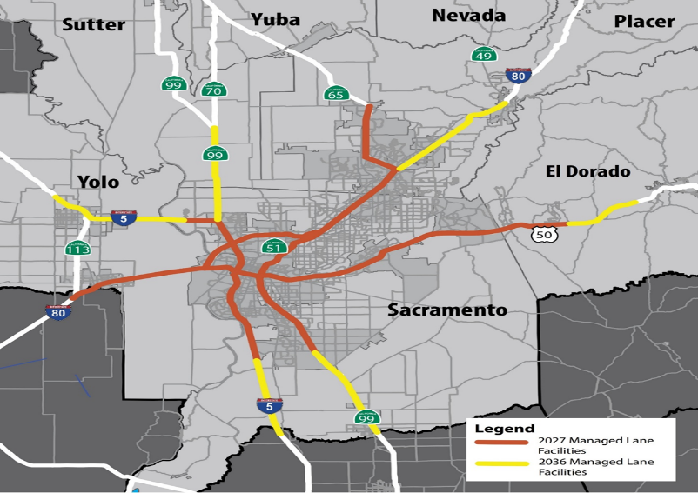
Caltrans District 3 Managed Lanes Network
Numerous large corridor projects; some include capacity-enhancements
Quantifiable, project-specific VMT impacts unknown until PA&ED phase environmental analysis is performed.
TBD
Unless project alternatives are ‘mitigated by design’ (e.g. via inclusion of pricing or other TDM strategies as project features), we can anticipate potential inducement effects (i.e. VMT impacts)
TBD
Most large corridor projects span several jurisdictions
Numerous VMT mitigation options available throughout region

Slide 3
Project Description
Bike Share: 50 Corridor Transportation Management Association and cities of Sacramento, West Sacramento, Davis, Folsom, and Rancho Cordova
The cities of Davis, Sacramento, and West Sacramento have all partnered with the bikeshare company JUMP to launch an all-electric bike-share fleet of 300 bikes and includes plans to expand to 900 bikes
Also developing a low-income program called ‘Boost’.
50 Corridor Transportation Management Association teamed up with LimeBike to bring a 200 bike share program to Folsom and Rancho Cordova to serve light rail stations at the eastern end of SacRT’s Gold Line.
Also establishing a LimeBike Business Network to provide companies w/ bike commute incentives

Slide 4
Project Description
Microtransit/On-demand Rideshare: Sacramento Regional Transit District (SacRT) and cities of Sacramento and West Sacramento
SacRT completed a microtransit pilot called ‘SmaRT Ride” in Citrus Heights and is expanding into suburbs of Orangevale, Antelope, and Fair Oaks, as well as the Historic Folsom light rail station, the Franklin Blvd. corridor, and areas of South Sacramento around City College, with plans to expand into to ten suburban service areas
The City of Sacramento and the Sacramento Regional Transit District are partnering with Sacramento State and CivicLab to pilot a last-mile autonomous shuttle service between the University/65th Street Light Rail station and the Sacramento State campus.
City of West Sacramento is deploying an on-demand microtransit, or rideshare, pilot in partnership with the firm VIA to integrate emerging trends and new technologies to determine where its traditional transit services can be enhanced or augmented through the deployment of neighborhood-level microtransit service to attract greater ridership.

Slide 5
Projected VMT Reduction
As recently-initiated pilot efforts, performance analysis is currently taking place and data is forthcoming.
Early indicators of VMT reduction:
JUMP Bike: Just within the first four days of its existence, 800 people joined the program and logged over 1,800 rides.
SmaRT Ride: Due to increased requests, the service hours will be expanded an additional three hours to operate from 6 a.m. to 9 p.m.

Slide 6
Evidentiary Basis
City of West Sacramento On-Demand Rideshare Pilot: Includes a share-data agreement and subcontract with UC Berkeley’s Transportation Sustainability Research Center to provide performance evaluation, including VMT reduction
Sacramento Regional Transit: Graphs below show both the ridership increases and customer satisfaction rates achieved during the initial phase of SacRT’s on-demand microtransit pilot
Customers, dispatchers, and operators generally feel that the app is easy to use and the system is easy to operate, resulting in positive feedback.
Consequently, the service is being adopted by new RT customers, ridership is growing, and SacRT is planning to expand the service in other suburban areas of Sacramento.
There have been no trip-denials and fewer trip cancelations/no-shows.
SacRT has new access to great data and statistics.

Slide 7
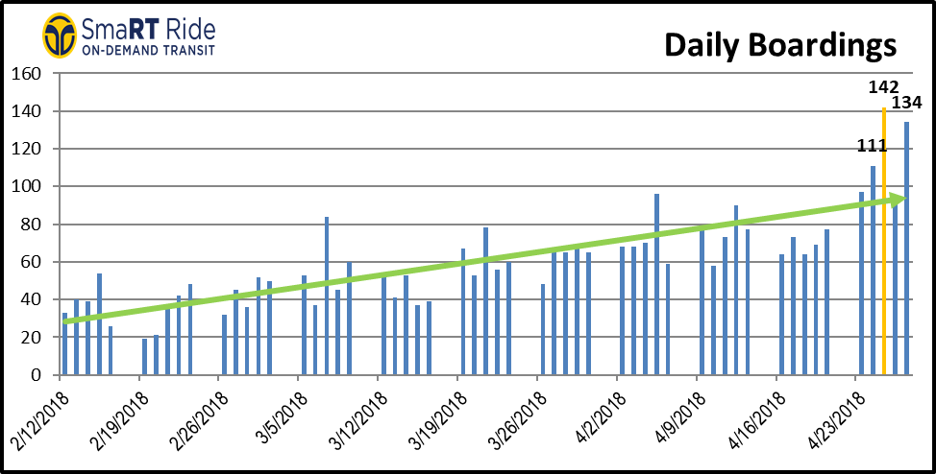

Slide 9
Payment, exchange, inducement required
These programs have expressed a desire to expand their services throughout the Sacramento area’s extensive suburban network and face funding shortfalls that limited their ability to do so.
However, the expansion plans and associated funding needs for each service differ by agency.
Further, mitigation requirements will differ by transportation project.
As such, the ‘payment’, ‘exchange’, or ‘other inducement’ required would need to be developed based on the specifics involved, both with regard to the VMT reduction service itself and any transportation projects needing mitigation.

Slide 10
Types of entities interested
CEQA lead agencies & transportation project sponsors with mitigation requirements
CEQA responsible agencies that want to ensure implementation of mitigation
Service providers that want to expand their programs & augment limited grant funding
Jurisdictions & employers that want to invest in innovation, strengthen recruitment/retention, & promote their civic/corporate brands

Slide 11
Types of entities interested
Ideally, this could happen through a two-step process, linking a programmatic regional partnership with project-specific agreements:
A) First, a CEQA lead or responsible agency (e.g. City/County, Caltrans, SACOG, SGC, ARB, etc.) could convene a regional VMT mitigation partnership group and establish a Charter between participants that outlines a process for developing subsequent project-specific agreements.
B) Then, as the environmental documents for specific transportation projects quantify individual VMT impacts in need of mitigation, requests for bids could be distributed to those partners who have expressed an interest in receiving funds to expand their services in exchange for supporting documentation of the VMT reductions achieved through their service that could serve as the substantial evidence needed to demonstrate adequate mitigation under CEQA.
These ‘in-lieu fees’ could then be paid by the transportation project sponsor to the selected third party through a project-specific ‘cooperative agreement’, which would result in ‘off-site’ mitigation. This transactional model is commonly used across the state to achieve mitigation for biological resources

