Slide 1
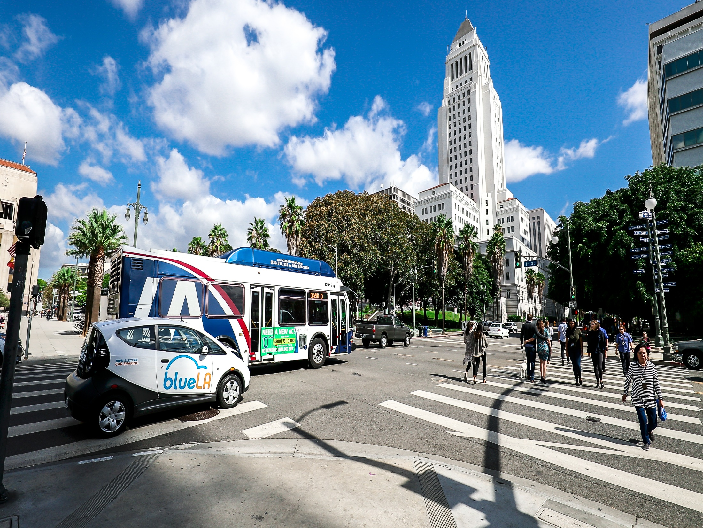
Reducing Vehicle Miles Travel by Investment in Transportation Management Organizations
City of Los Angeles
Departments of Transportation & City Planning

Slide 2
SCAG VMT EXCHANGE
How would a SCAG VMT Exchange TMA work?
The Regional VMT Exchange would fund Countywide or Area-wide TMA trust fund to reduce regional VMT
TMA’s are non-profit entity that manages the transportation needs of their members
TMAs develop, implement and evaluate the effectiveness of TDM strategies to reduce driver-alone trips
To receive funding TMA would become certified by granting agency
Notes:
TMA’s are non-profit entity that manages the transportation needs of a coalition of employers, property owners, businesses or community members

Slide 3
ESTIMATED VMT REDUCTION: TMO/TMAs
Regional
Portland TMAs estimated to reduce a total 0.03% VMT at the regional level
Project Level
TMAs alone can lead to 6-7% commute trip reduction
Voluntary Commute Trip Reduction Programs = 1% - 6.2% commute VMT reduction
Required Commute Trip Reduction Programs = 4.2% - 21% commute VMT reduction
Notes:
http://www.westsidemobilityplan.com/wp-content/uploads/2016/06/Nexus-Study-6.03.16.pdf
PAGE 35

Slide 4
ANTICIPATED COSTS
Approximate costs per area-wide TMA: $2M
One-time Vehicle Miles Reduced (VMR) fee
Costs would include:
Initiation fees
Operating costs
TDM Guidance
TMA membership dues fund ongoing costs
Notes:
Vehicle Miles Reduced (VMR) fee
One-time fee would be charged to new development that is proportional to the VMT impact the proposed project is anticipated to generate.

Slide 5
INTERESTED ENTITIES
Possible Interested Parties
Major developers
Lead agencies who are updating their general plan
Transportation agencies proposing a road capacity enhancement
Notes:
Major developers aiming to build in areas of the region predominantly accessible by car, with few other transportation options
Lead agencies who are updating their general plan that would expand capacity and increase VMT
Transportation agencies proposing a road capacity enhancement or new public transportation project

Slide 6
USE CASE: WESTSIDE MOBILITY PLAN
Trip fees for new development are leveraged to build projects that reduce VMT
0.75% of trip fee funds $2M of the TMO costs
Fee covers 35% of estimated project cost
Fee only required of land use projects
Nexus based on 2035 plan horizon year
Notes:
Good morning, you may remember us from December 2017
We were here to present initial concepts and we had a very robust conversation and heard a lot of great questions and comments from you
We’ve really been thinking through and updating our efforts to take into account what we heard and clarify where there was confusion
Today we are back and first and foremost we want to overview the questions we received in December to refresh all of us
We also want to show updated slides that we hope can answer questions and concerns we heard in December
If you have additional questions or follow ups, we want to leave some additional time for that

Slide 7
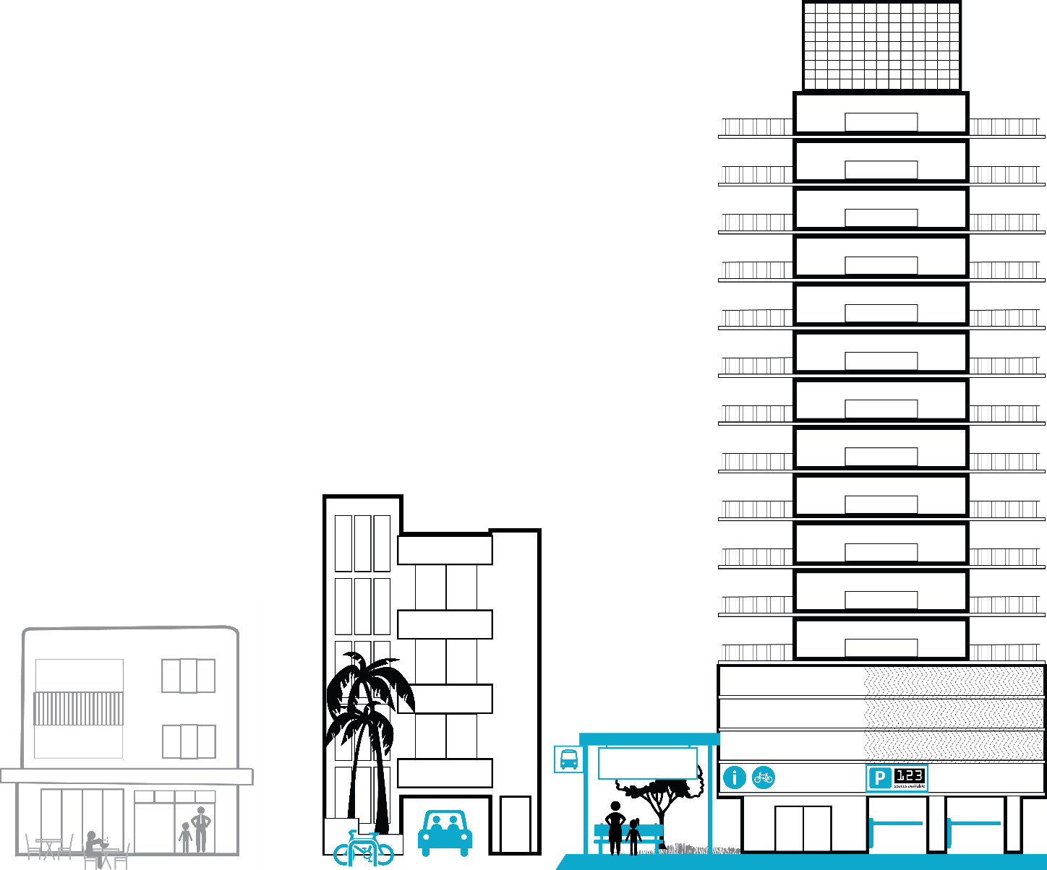
USE CASE: WESTSIDE MOBILITY PLAN
Example TMO fees* (covers 35% of costs)
100 unit subdivision = $6,635
50 unit apartment building = $1,742
100 unit residential high rise = $2,103
250K sq ft office project = $31,414
*Fee rate is based on the Coastal Transportation
Corridor Specific Plan
Notes:
Good morning, you may remember us from December 2017
We were here to present initial concepts and we had a very robust conversation and heard a lot of great questions and comments from you
We’ve really been thinking through and updating our efforts to take into account what we heard and clarify where there was confusion
Today we are back and first and foremost we want to overview the questions we received in December to refresh all of us
We also want to show updated slides that we hope can answer questions and concerns we heard in December
If you have additional questions or follow ups, we want to leave some additional time for that

Slide 8
QUESTIONS
Setting horizon year in capturing VMR of induced demand of capacity-enhancing roadway projects. What future base year would need to be mitigated for transportation projects?
Full Cost Recovery of Project?
Notes:
Good morning, you may remember us from December 2017
We were here to present initial concepts and we had a very robust conversation and heard a lot of great questions and comments from you
We’ve really been thinking through and updating our efforts to take into account what we heard and clarify where there was confusion
Today we are back and first and foremost we want to overview the questions we received in December to refresh all of us
We also want to show updated slides that we hope can answer questions and concerns we heard in December
If you have additional questions or follow ups, we want to leave some additional time for that

Slide 9
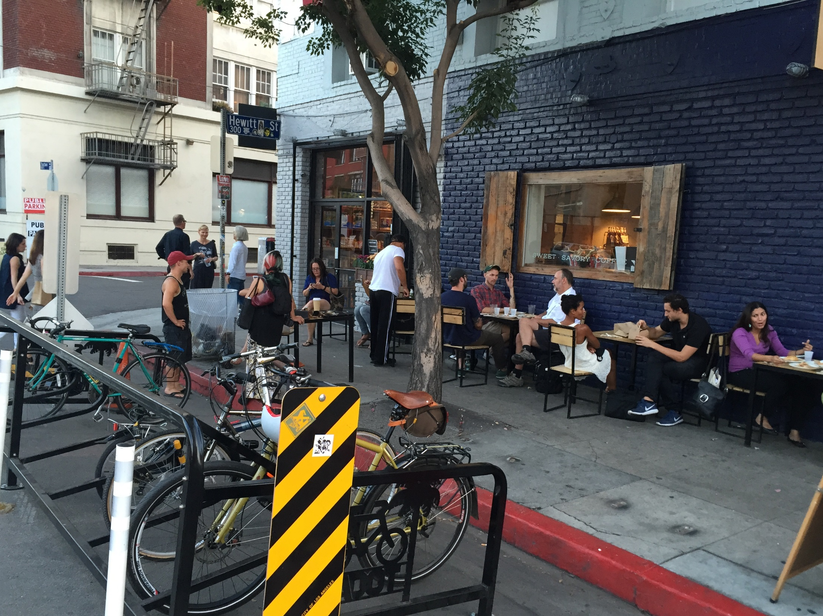
Questions & Comments
DAVID SOMERS
Department of Transportation
e-mail david.somers@lacity.org
RUBINA GHAZARIAN
Department of City Planning
e-mail rubina.ghazarian@lacity.org
WEBSITE: ladot.lacity.org/what-we-do/planning-development-review/transportation-planning-policy

